Slide 1
Arduino Based Solar Cell TestPlatform
HFDA
2013

Slide 2
Idea
Making a small, affordable platform, that can take systematic data from a solar cell under test
Enable taking IV curves (range from +-2V)
Log IV curve, Irradiance, Temperature (both cell and air), Time
Store on SD card and/or ethernet (www.cosm.com?) or pc.
Use directly with pc as a Keithley 2400 or as a headless standalone unit

Slide 3
Design Specs
Based on the IV tester of the MIT guys
Make Arduino sketch for my setup of IV scan:
1. Use MCP4728 DAC for setting the voltage output
feed output to channel A and B on OPAMP (enabling negative and positive part of sweep)
Channel C could be used for negatively biasing a photodiode (Intensity)
2. Use MCP3424 ADC for measuring current and voltage
12/14/16bit with four channels differentially
enables measurement of voltage over DUT, R_shunt and OP_AMP
Last channel could be used for photodiode (Voltage over R_shunt or bolometer which is in mV)
3. DHT11 or DHT22 incorporation for environment conditions
x. Temperature sensor DS18 one wire
x. SD-card storage of files instead of serial (stand alone tester)
x. Ethernet connection
x. RTC chip with temp readout
used for storing data no sd-card with filenames for date and time
X. sleep mode with RTC wakeup

Slide 4
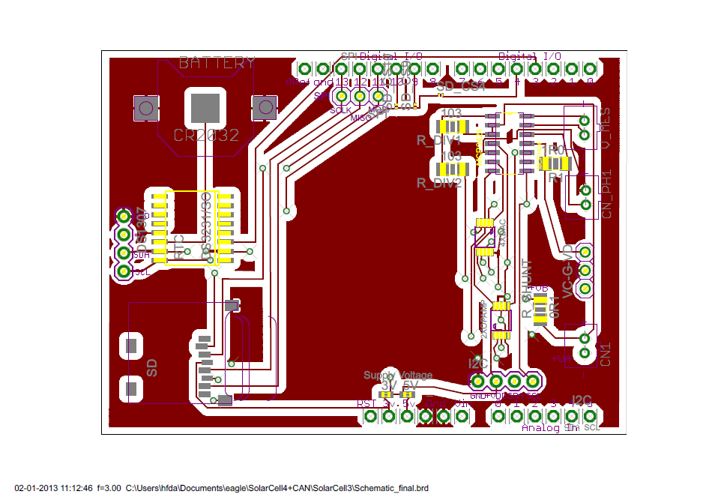
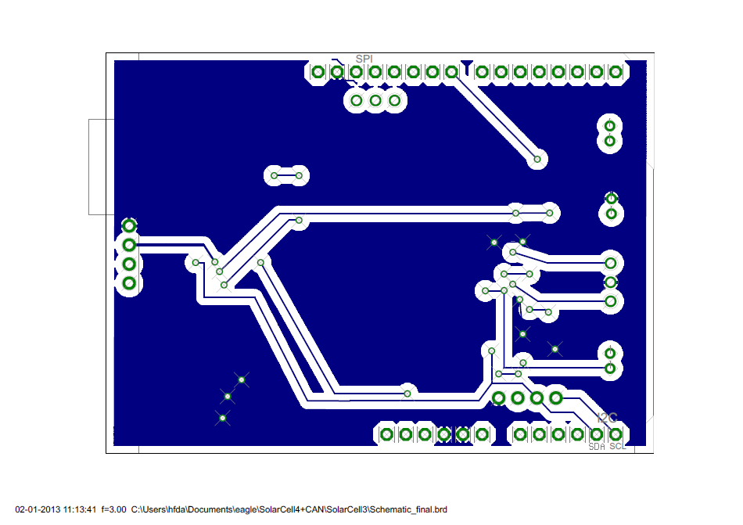
Diagram
Top layer
Bottom layer

Slide 5
Diagram
Top layer
Bottom layer

Slide 6
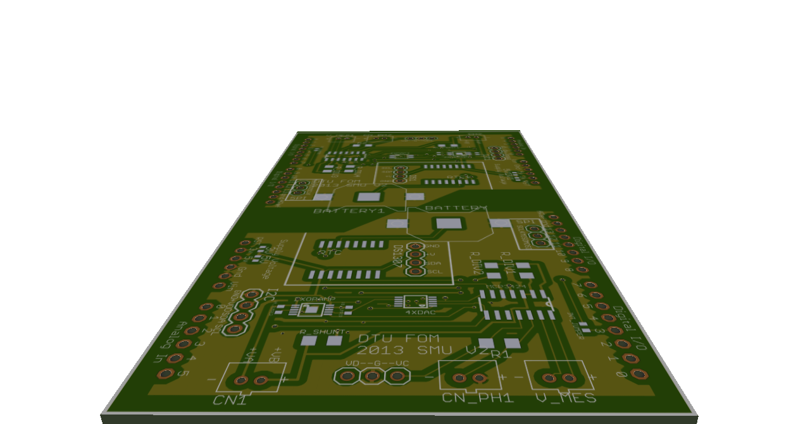
Layout v2 Components
2x 20 kOhm
0.1 Ohm Shunt
MCP3424 ADC
TLV4113 OPAMP (optional)
Top layer
MCP4728 DAC
OPAMP bypass

Slide 7
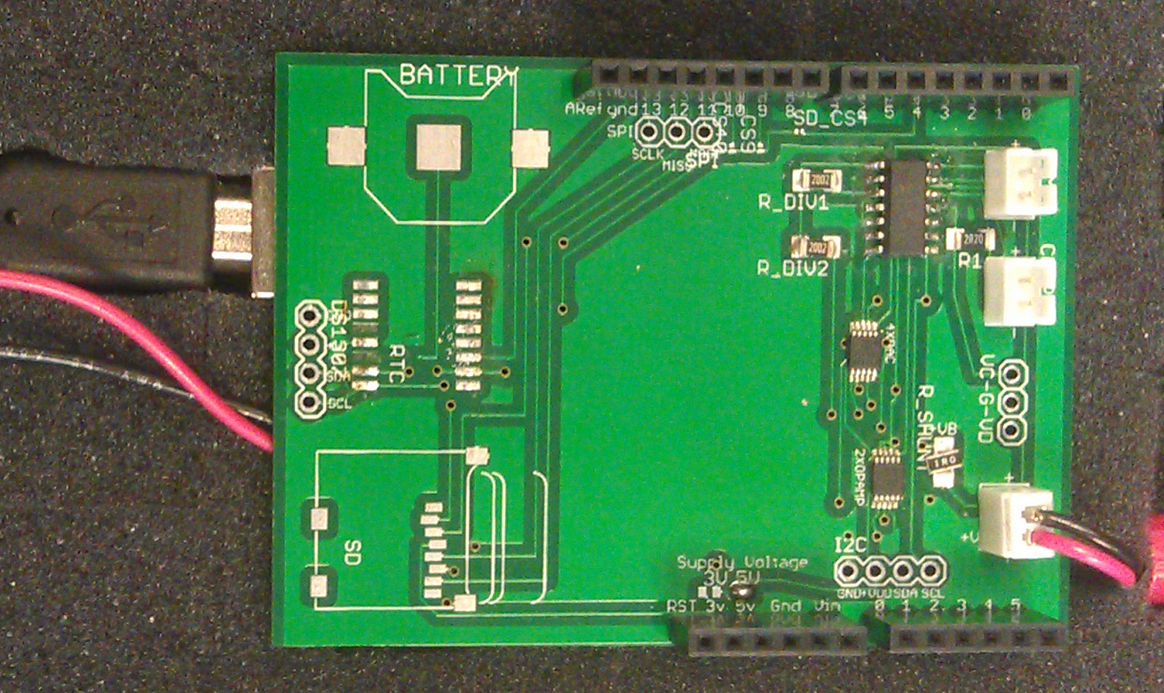
2x 20 kOhm
MCP3424 ADC
MCP4728 DAC
0.1 Ohm Shunt
TLV4113 OPAMP (optional)

Slide 8
Software (embedded)
########### Implementing software ##############
include libraries:
Wire
MCP4728
MCP3424
SD
OneWire
DallasTemperature
DHT
Ethernet
Defining variables
Setting std range of -1V to 1V
Setting common voltage on Va and Vb to 1.5V
Setting # points = 200

Slide 9
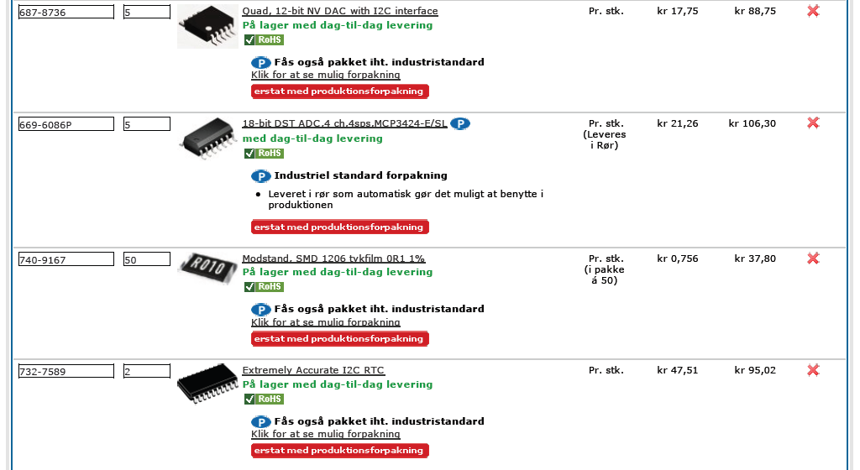
Components

